Slide 1
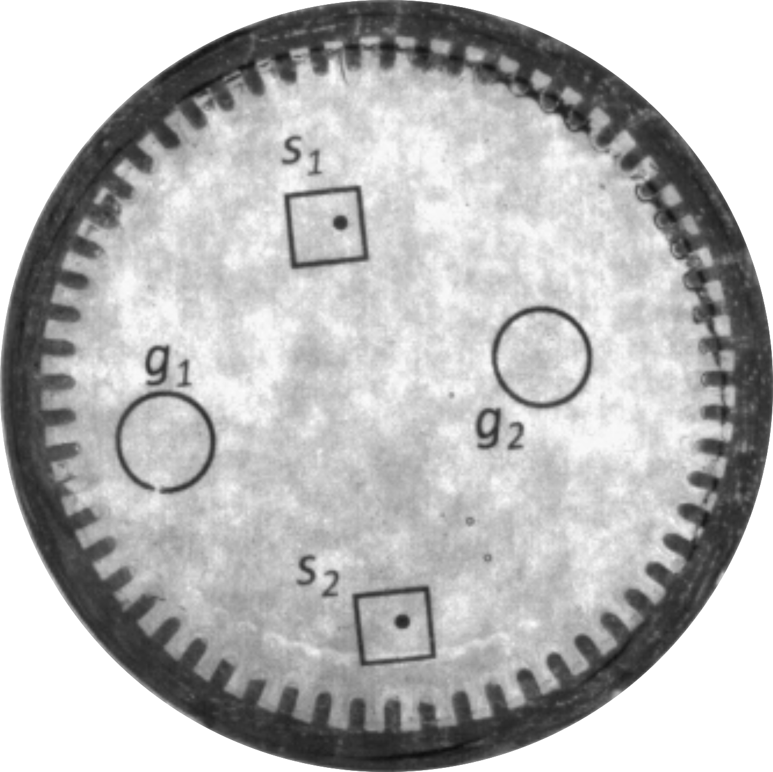
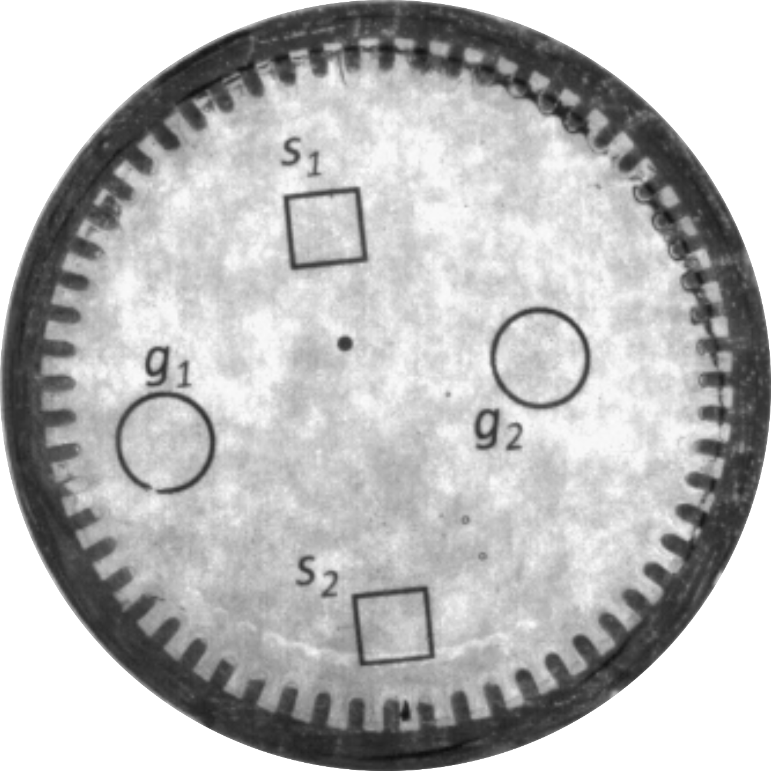



5 mm
5 mm
5 mm
5 mm
5 mm
0.5 mm magnets

